Slide 1

Optimizing Predictive Modeling: A Comprehensive Study of Data Handling and Model Selection Strategies
Presented by: Appaji Yaddla

Slide 2

About Me
Background: I hold an MSc in Mathematics from Andhra University, where I developed a strong foundation in mathematical principles and analytical thinking.
Reason: I am passionate about applying my mathematical skills and analytical mindset to explore new career opportunities.
Work Experience: I have worked as a Software Engineer, specializing in senior content development.

Slide 3


Optimizing Predictive Modeling: A Comprehensive Study of Data Handling and Model Selection Strategies
Welcome to our comprehensive exploration of the exciting world of data science and predictive modeling. In this presentation, we delve deep into the complexities of data handling and model selection strategies, empowering you with the knowledge and tools to drive impactful outcomes. Join us on this thrilling journey as we uncover the intricacies of data preprocessing, feature engineering, and the art of choosing the most suitable modeling techniques for your specific challenges.
by Appaji Yadla

Slide 4
Project Objectives
1
Explore Data Handling Methodologies
2
Enhance Decision-Making in Data Science
We aim to conduct a thorough investigation into the various data handling methodologies, including preprocessing techniques and feature engineering, to enhance the accuracy and reliability of our predictive models.
By exploring various evaluation techniques and feature selection methods, we will empower participants to make informed decisions and improve the performance of their predictive models, ultimately driving impactful outcomes.
3
Understand Model Interpretability
4
Selecting the target variable
As part of our project, we have the freedom to select our target variable. We have chosen "Bene_Avg_Risk_Scre" as our target variable for this analysis.
We will delve into techniques like feature importance analysis to enhance the interpretability of our models, enabling stakeholders to gain deeper insights and make more informed decisions based on the underlying patterns and relationships within the data.

Slide 5
Understanding Target Variable
Bene_Avg_Risk_Scre
Hierarchical Condition Category (HCC) Risk Score: HCC risk scores are calculated based on the presence and severity of specific medical conditions diagnosed in individuals. These conditions are categorized into hierarchical groups, and each category is assigned a weight reflecting its impact on healthcare costs. By summing the weights of all conditions present in an individual, a risk score is generated, which serves as an estimate of their expected healthcare expenditure.

Slide 6
Workflow
Preparation
1
We will kick off the project by preparing an overview report that outlines our project progression strategies, ensuring a clear roadmap for the entire endeavor.
2
Exploratory Data Analysis
Our team will dedicate three days to conducting a thorough Exploratory Data Analysis (EDA), uncovering the underlying patterns, trends, and relationships within the dataset.
Machine Learning Algorithms
3
Over the next two days, we will build and compare various Machine Learning (ML) algorithms, evaluating their performance and suitability for our predictive modeling objectives.
4
Artificial Neural Network
Finally, we will construct an Artificial Neural Network (ANN) model within the last two days, leveraging its powerful capabilities to enhance the accuracy and reliability of our predictive insights.

Slide 7
Overview of Medicare Beneficiaries and Providers Data Ecosystem
Beneficiaries
Providers
Medicare enrollees who receive healthcare services covered by the Medicare program. They are the recipients of medical care and services provided by healthcare professionals.
Healthcare professionals who deliver medical services to Medicare beneficiaries. This includes doctors, specialists, therapists, and other practitioners involved in patient care.
How the System Runs
The CMS administrative claims data contains information on services rendered to Medicare beneficiaries by healthcare providers. This data is collected and processed to generate insights into utilization patterns, payment amounts, and other metrics related to healthcare delivery and reimbursement.

Slide 8
Finding Missing Values
Variable
Missing Values
Variable
Missing Values
Bene_CC_AF_Pct
391,632
Bene_CC_Dbts_Pct
188,164
Bene_CC_Alzhmr_Pct
399,844
Bene_CC_Hyplpdma_Pct
87,114
Bene_CC_Asthma_Pct
499,270
Bene_CC_Hyprtnsn_Pct
68,346
Bene_CC_Cncr_Pct
399,408
Bene_CC_IHD_Pct
186,774
Bene_CC_CHF_Pct
304,360
Bene_CC_Strok_Pct
564944
Bene_CC_CKD_Pct
181,237
Rndrng_Prvdr_Gndr
64836
Bene_CC_COPD_Pct
363,331
Drug_Sprsn_Ind
1059977
Bene_CC_Dprssn_Pct
190,635
Med_Sprsn_Ind
1059977
It seems like the columns Drug_Sprsn_Ind and Med_Sprsn_Ind have a significant number of missing values. We might want to handle these missing values before proceeding with further analysis or modeling.

Slide 9
Handling Missing Values
Handling Missing Values
Imputing Suppressed Data
Filled missing values in "Rndrng_Prvdr_Gndr" with 'NA', indicating that the provider is registered as an organization, leaving the gender blank.
For features like Drug_Sprsn_Ind and Med_Sprsn_Ind, null values were filled with 'NA' to accurately handle suppressed utilization and cost information, typically based on fewer than 11 beneficiaries. We also imputed null values in specified columns with 10/df['Tot_Benes'] to maintain dataset integrity while addressing suppressed data.

Slide 10
Correlation Analysis
Key Observations with target variable
Category
Feature
Corr. with Bene_Avg_Risk_Scre
Strong Positive Correlation
Bene_CC_Dprssn_Pct
0.380412
Bene_CC_Dbts_Pct
0.668845
Bene_CC_IHD_Pct
0.665987
Bene_CC_Strok_Pct
0.500808
Moderate Positive Correlation
Bene_CC_Cncr_Pct
0.200816
Bene_CC_CHF_Pct
0.768951
Bene_CC_CKD_Pct
0.796102
Bene_CC_COPD_Pct
0.618000
Negative Correlation
Rndrng_Prvdr_RUCA
-0.042329
Tot_HCPCS_Cds
-0.019413
Tot_Benes
-0.004515

Slide 11
Correlation Analysis
1
Significant Correlations
Our correlation analysis has unveiled that certain medical conditions, including depression, diabetes, and heart diseases, exhibit a substantial impact on the average risk score. These conditions display strong positive correlations with the target variable 'Bene_Avg_Risk_Scre'.
2
Feature Selection for numerical columns
Bene_CC_AF_Pct
Bene_CC_Alzhmr_Pct
Bene_CC_Asthma_Pct
Bene_CC_Cncr_Pct
Bene_CC_CHF_Pct
Bene_CC_CKD_Pct
Bene_CC_COPD_Pct
Bene_CC_Dprssn_Pct
Bene_CC_Dbts_Pct
Bene_CC_Hyplpdma_Pct
Bene_CC_Hyprtnsn_Pct
Bene_CC_IHD_Pct
Bene_CC_Strok_Pct
3
Strategy
Chosen features with a correlation greater than 0.2 with the target variable for further investigation and model development.

Slide 12
Exploratory Data Analysis (EDA)
During the EDA phase, we displayed histograms for the numeric columns to gain a better understanding of their distributions. Additionally, we presented count plots for the categorical columns, providing valuable insights into the frequency and trends within the data.

Slide 13
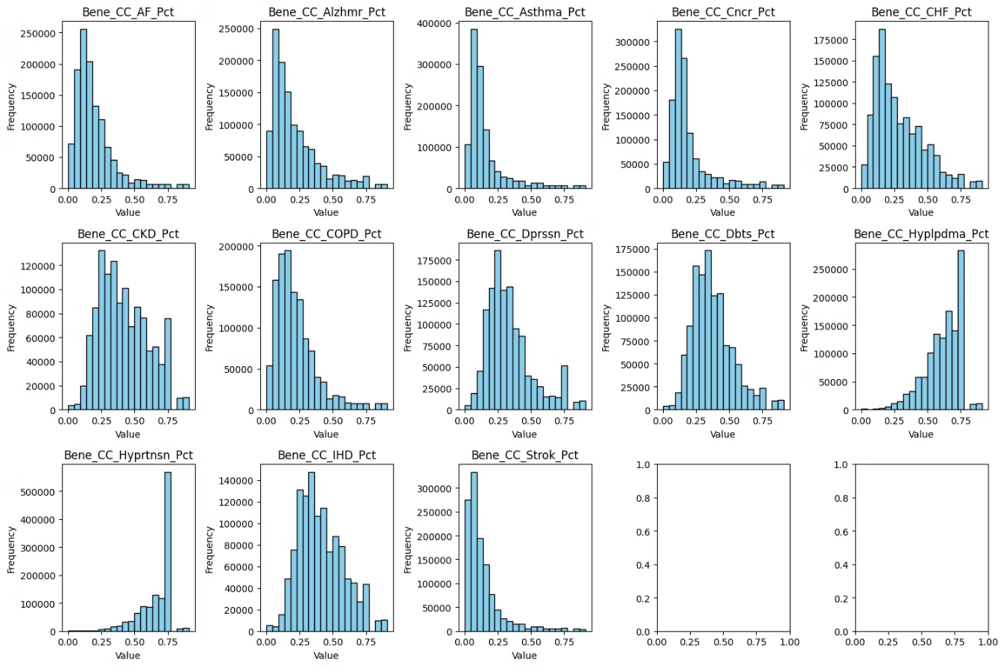

Slide 14
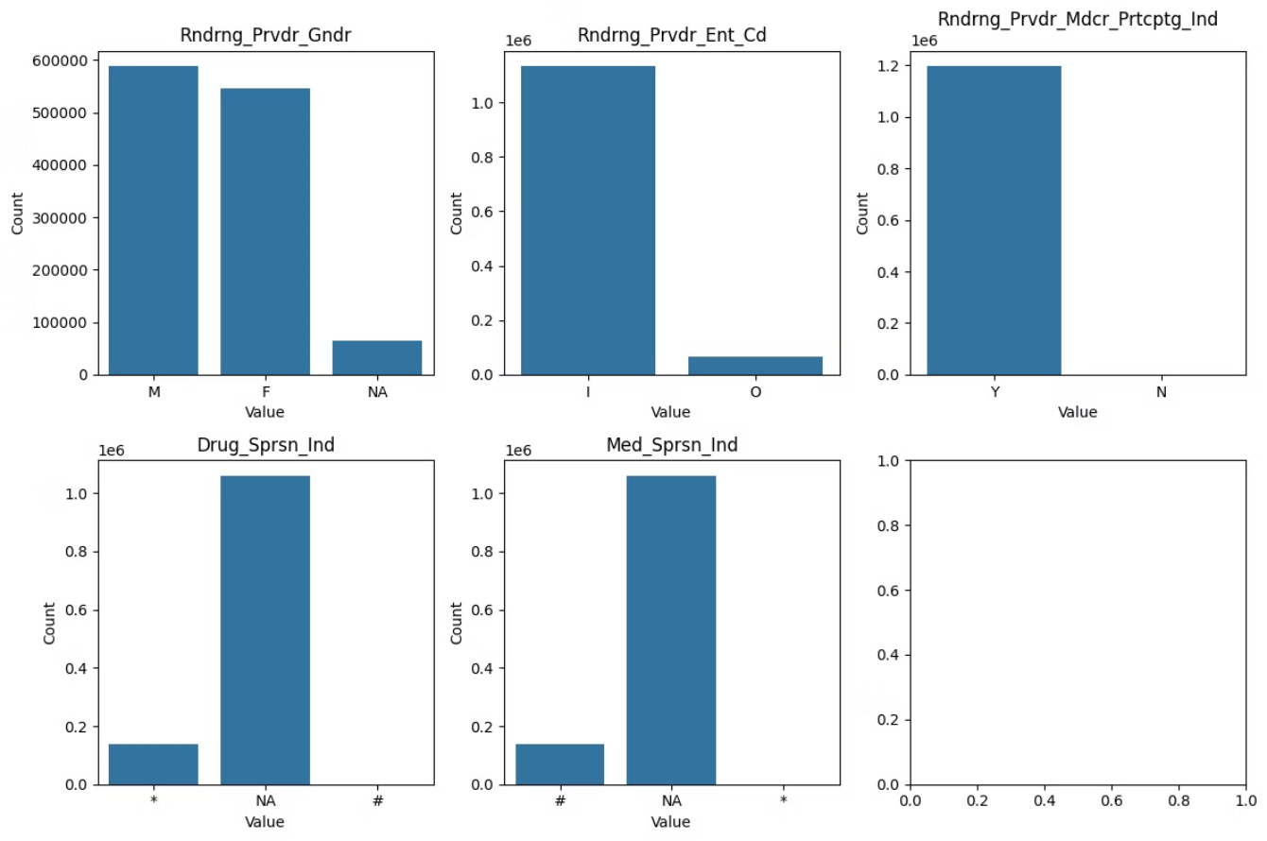

Slide 15
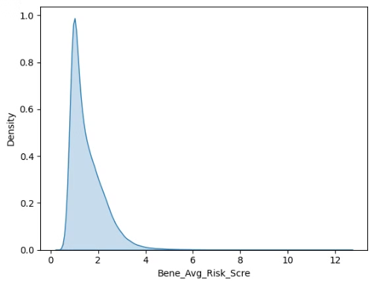
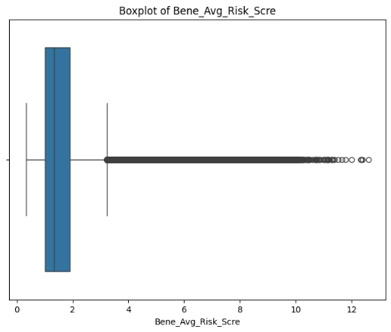
KDE Plot Analysis
The KDE plot for the target variable "Bene_Avg_Risk_Scre" displayed a right-skewed distribution, with a peak occurring at approximately 1.5. This observation suggests that the majority of the data points are concentrated towards the lower end of the scale, with fewer instances of higher values.
Box Plot Analysis
Upon examination of the boxplot, it became evident that outliers were present in the dataset. The lower whisker extended to approximately 0.5, the median (represented by the horizontal line inside the box) was around 1.5, and the upper whisker reached a value of approximately 3.5. These approximate values provide insights into the distribution of the data and highlight the presence of outliers beyond the upper whisker.

Slide 16
Outlier Removal Strategy
To address this, we decided to remove outliers greater than 4 standard deviations from the mean, aiming to mitigate the potential influence of extreme values on our analysis and modeling efforts.

Slide 17
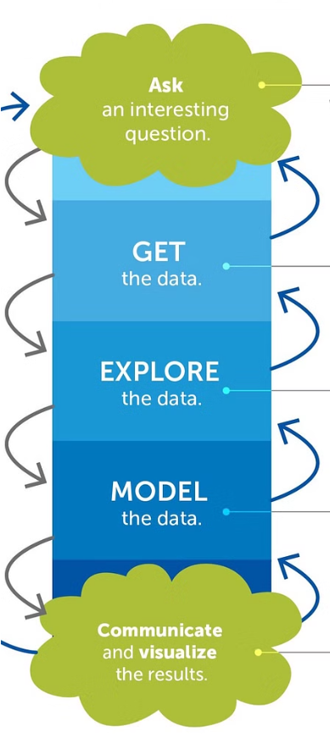


Model Building
Feature Selection and Preprocessing
We carefully selected the most relevant features based on the correlation analysis and preprocessed the data, including handling missing values, scaling numerical features, and one-hot encoding categorical features.
Model Comparison
We built and evaluated several models, including Linear Regression, Random Forest, KNN, and an Artificial Neural Network (ANN), to determine the most suitable approach for our predictive modeling objectives.

Slide 18
Evaluation Table
Model
Mean Absolute Error
Mean Squared Error
Root Mean Squared Error
Linear Regression
0.278
0.166
0.408
Random Forest
0.185
0.080
0.283
KNN
0.194
0.090
0.299
ANN
0.183
0.078
NaN

Slide 19
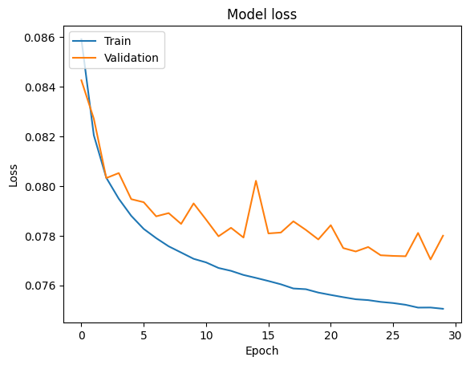
Model Loss ANN

Slide 20



Feature Importance Analysis
Medical Conditions
Utilization and Cost
Interpreting Model Insights
Our feature importance analysis revealed that medical conditions, such as depression, diabetes, and heart diseases, are the most influential factors in predicting the average risk score. This aligns with the insights from our correlation analysis and underscores the critical role of health-related data in driving accurate predictive models.
Features related to healthcare utilization and cost, such as the number of beneficiaries and suppressed data indicators, further contribute to the accuracy of our predictive models. By incorporating these variables, we can gain a more holistic understanding of the factors influencing the average risk score.
The feature importance analysis provides valuable insights into the key drivers of the target variable, enabling us to interpret the models more effectively and make data-driven decisions. This understanding enhances our ability to optimize predictive modeling and deliver meaningful, actionable insights to stakeholders.

Slide 21

Conclusion
In conclusion, our comprehensive study of data handling and model selection strategies has yielded remarkable insights and valuable outcomes. The Artificial Neural Network (ANN) model has emerged as the top performer, outshining the Linear Regression, Random Forest, and KNN models in terms of accuracy and reliability. This finding underscores the power of deep learning techniques in capturing the intricate patterns and relationships within complex datasets.

